Slide 1


Capstone Project
Football Data Analysis
Insights and Strategic Recommendations
REPRESENTER: AMAN SAGAR
ENROLMENT NUMBER: EN12024081726
MENTOR: SHARYOO DIXIT & ROHIT KAMBOJ
PROGRAM: PROFESSIONAL PROGRAM IN DATA ANALYTICS

Slide 2
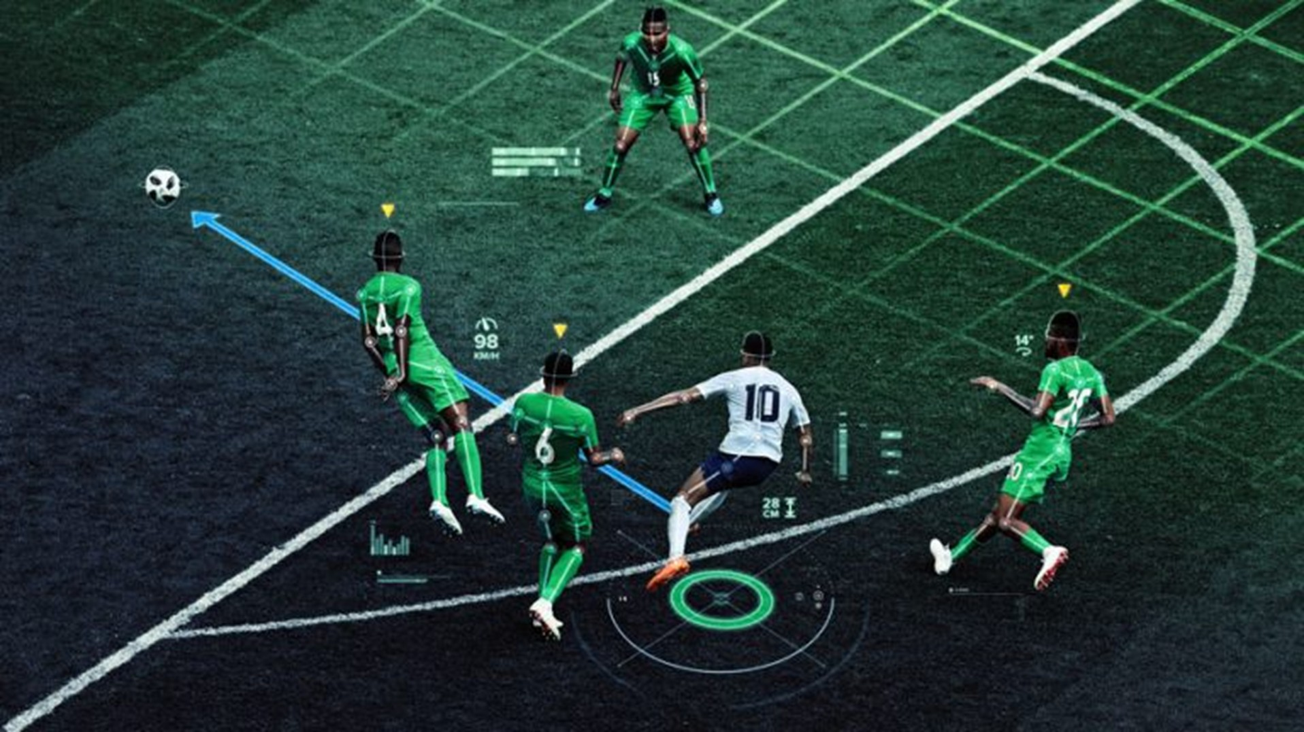
Insights
Performance Analysis
Top Performers: Evaluate and analyze both player and team performance by examining individual metrics such as goals, assists, yellow cards & red cards.
Home vs. Away Performance: Assess team metrics including home and away goals.
Player Profile and Market Value
Correlation Analysis: Analyze market value trends of players based on age.
Market Value Analysis: Analyze market value trends of players based on position.
Substitution Patterns
Impact of Substitution Timing on Team Performance: Analyze substitution timing and its impact on team performance, including goals scored after substitutions, while evaluating the most frequently substituted positions and the tactical rationale behind these decisions.
Managerial Substitution Strategies and Their Effectiveness: Compare the effectiveness of substitutions made by different managers across multiple competitions while identifying patterns in substitution usage between winning and losing teams to understand strategic differences.
Event and Attendance Analysis
Event Trend: The final score line while identifying recurring event patterns that differentiate successful teams from unsuccessful ones.
Attendance Correlation: Analyze the attendance at events changed over the past years in terms of growth, decline, and recovery.
NOTE-For every focus areas ,created two questions with visuals.

Slide 3
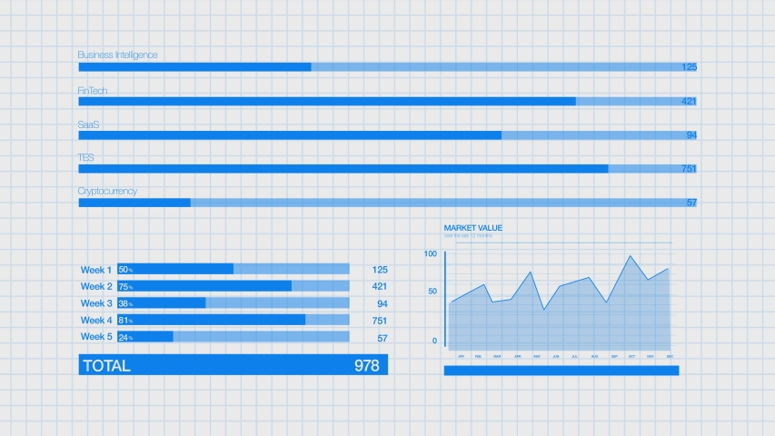





Format
Conversion
MS Excel
Analyzing data
of all five excel files.
Software
Used For
Analysis
Database
MySQL
Importing all fives files
and connecting to python.
Analysis
&
Visualization
Python
Cleaning, treating, and
implemented focus areas.
Tableau
Performing visuals
and dashboards.
Word Processor
MS Word
Analyzing data
of all five excel files.

Slide 4
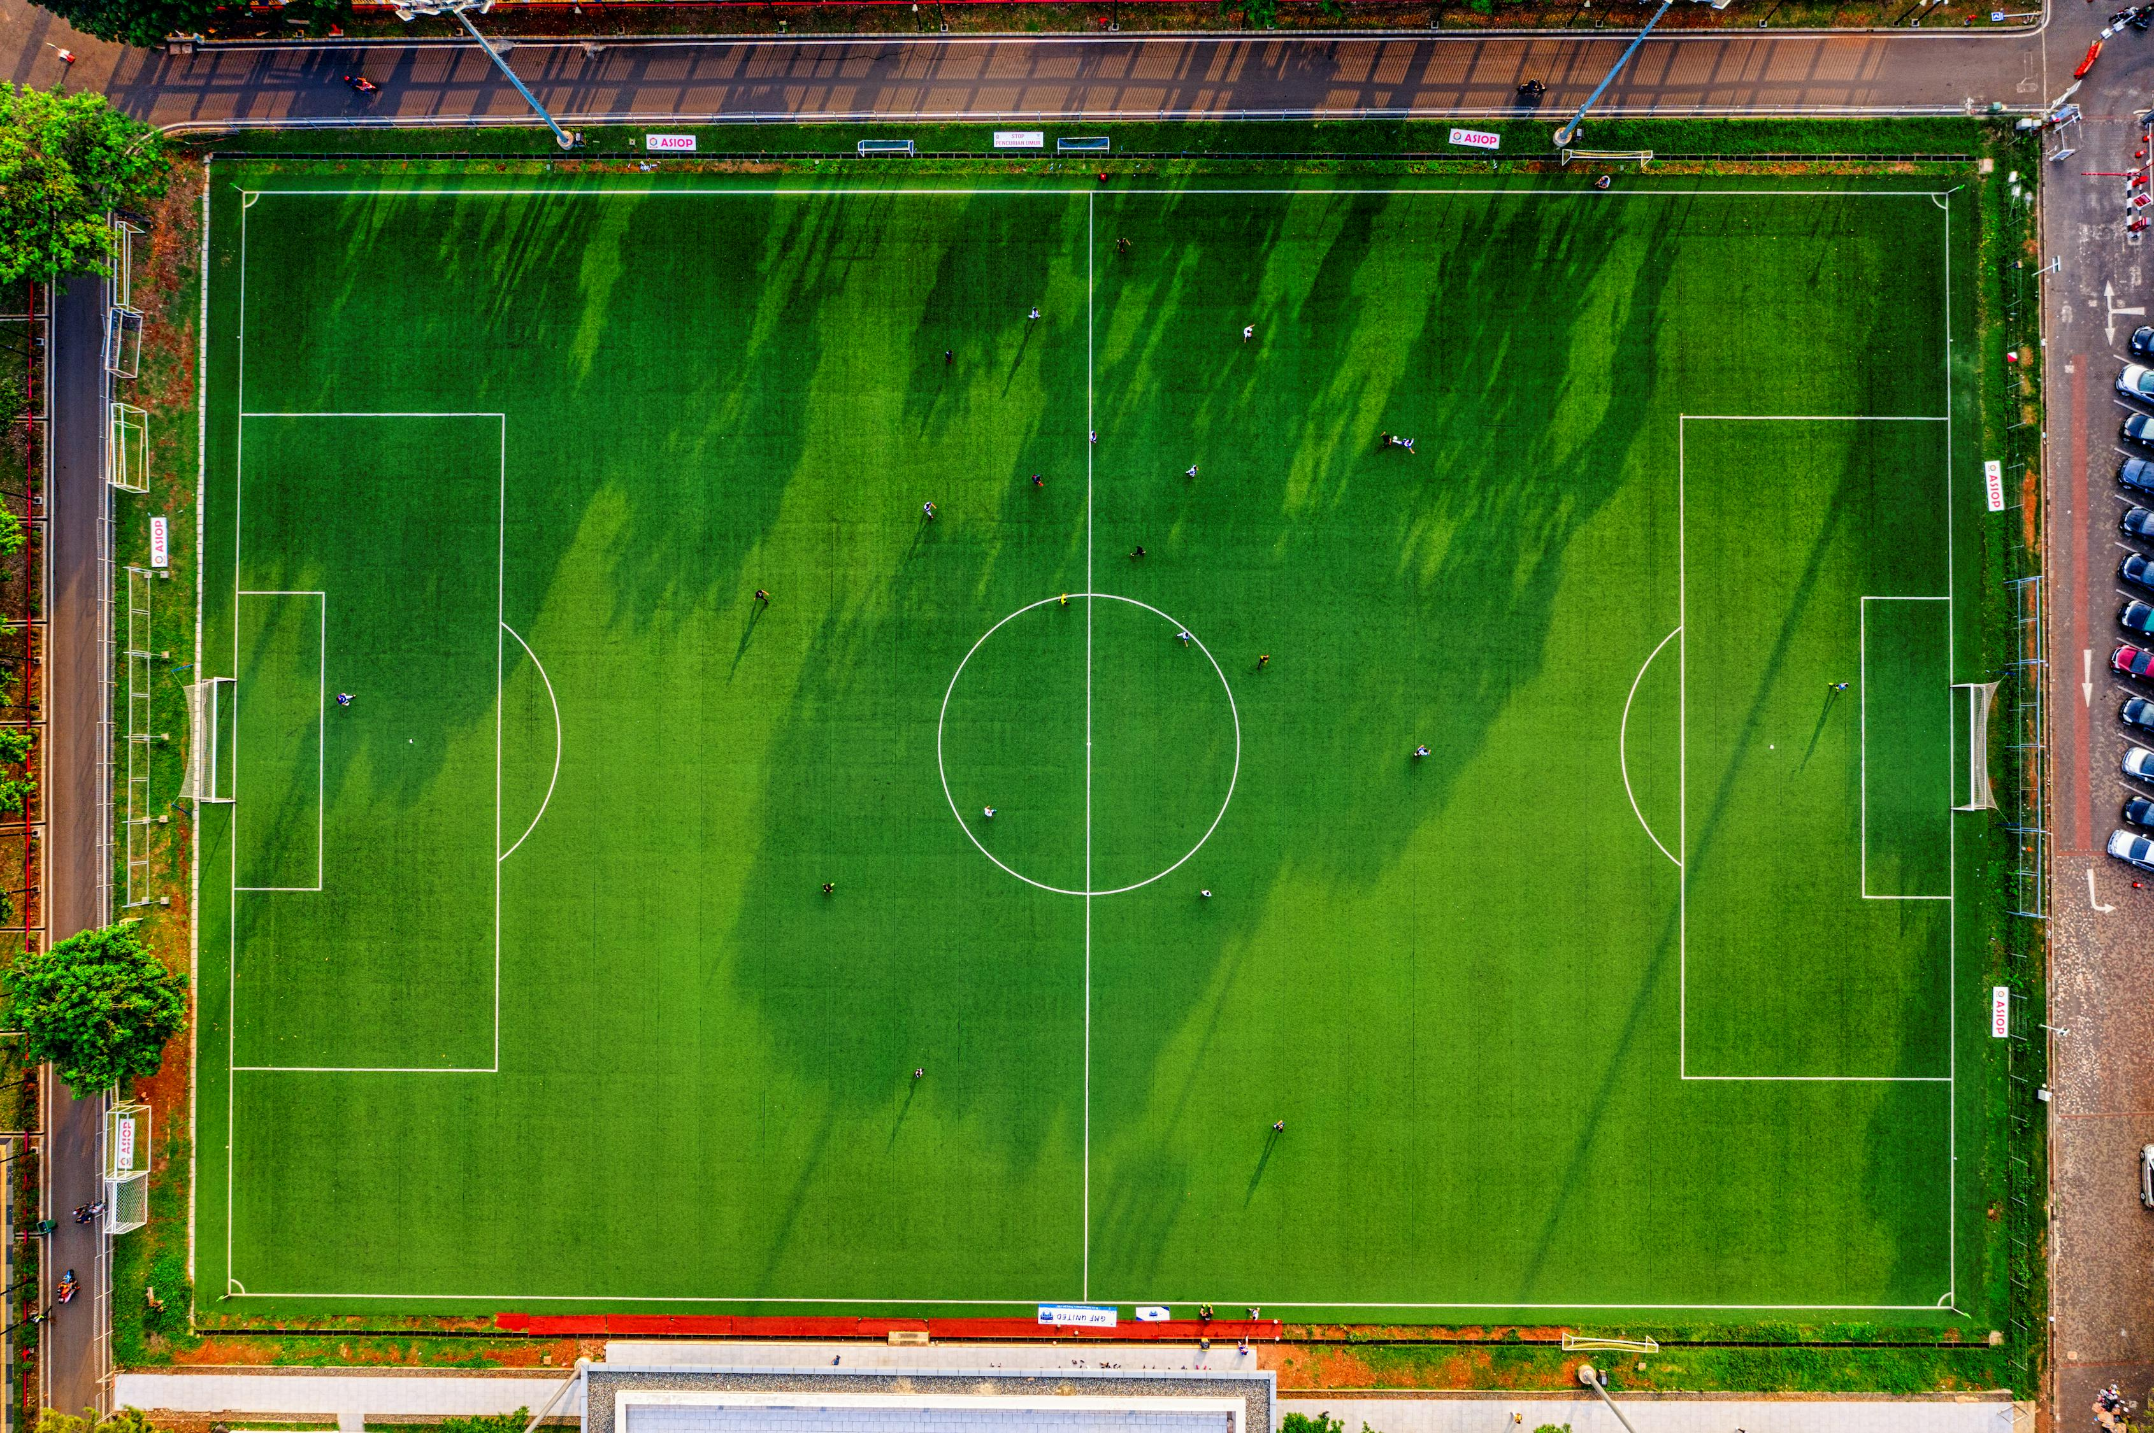
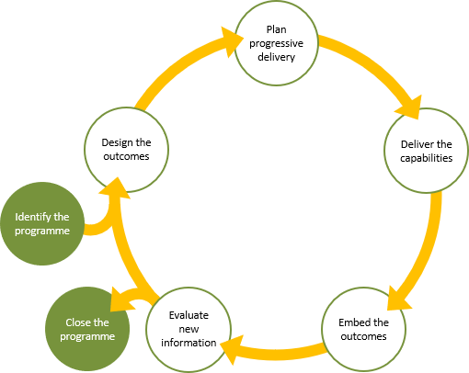
Analysis Cycle
Database
MySQL
Importing Data
Established Connection
Data Conversion
Python
Tableau
Visualization
Analysis
Preprocessing & Cleaning
Data Merging
Visualization

Slide 5

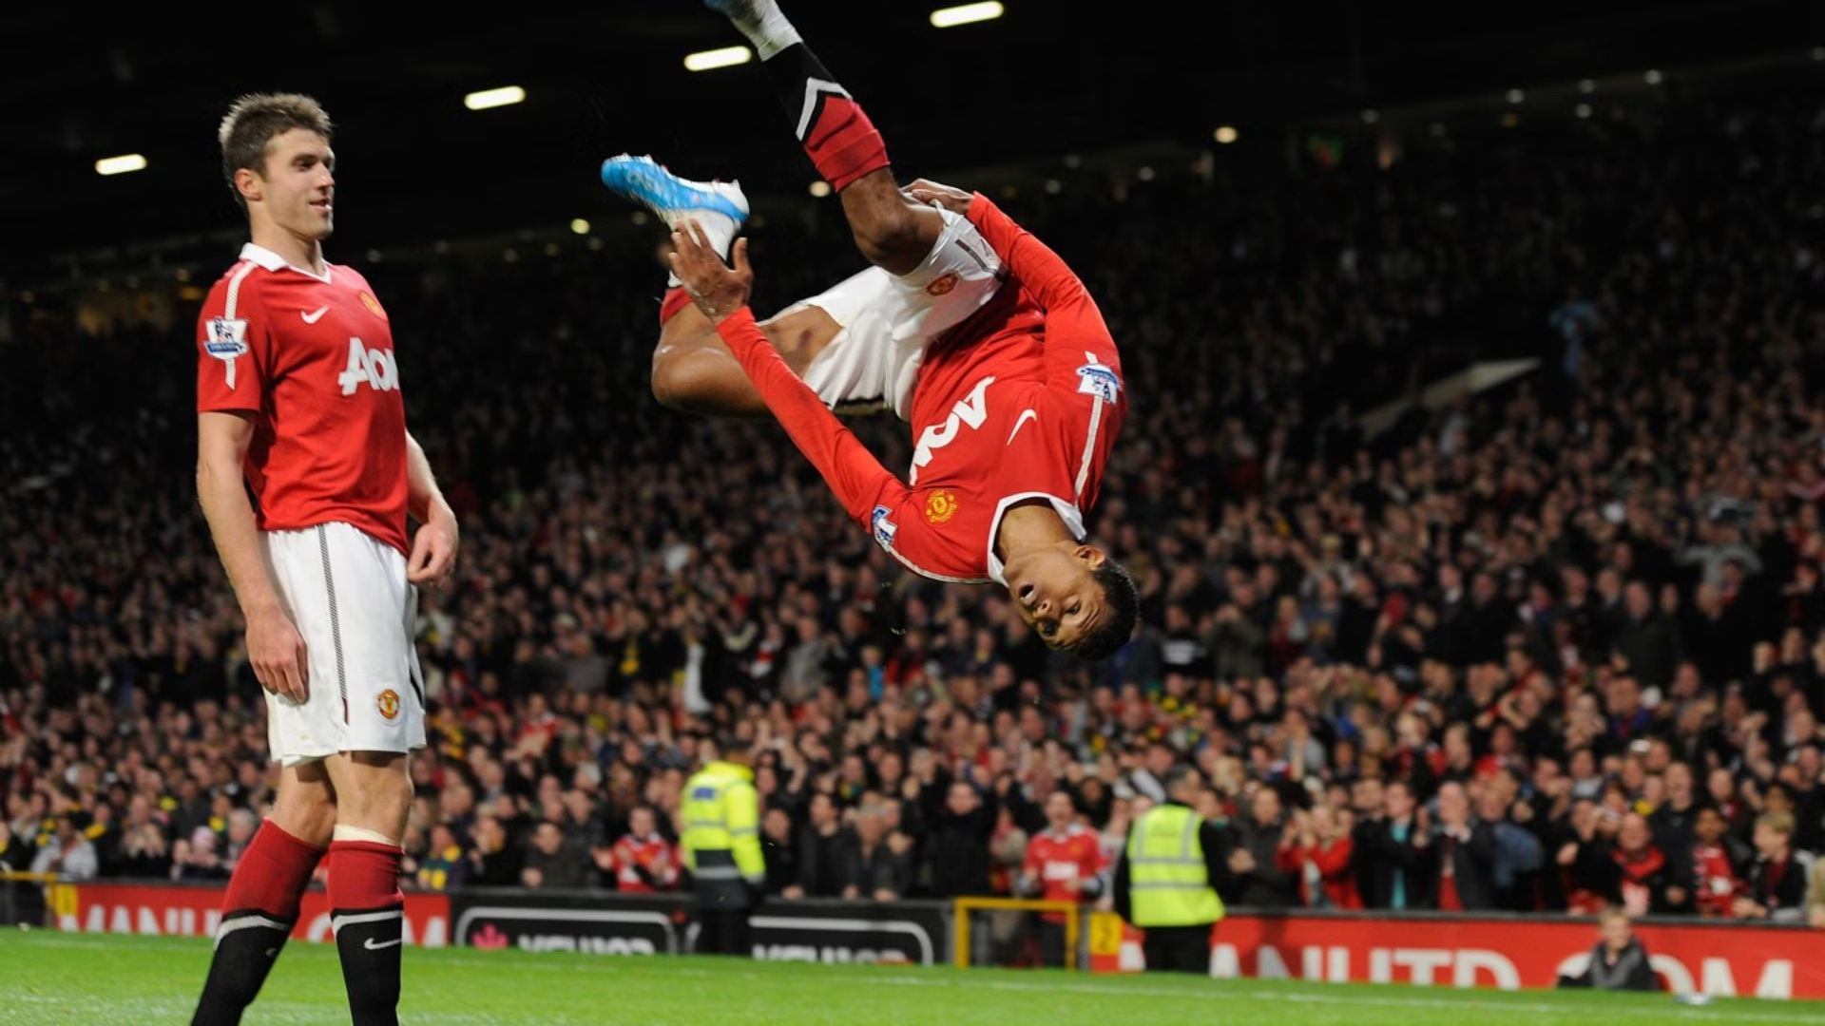
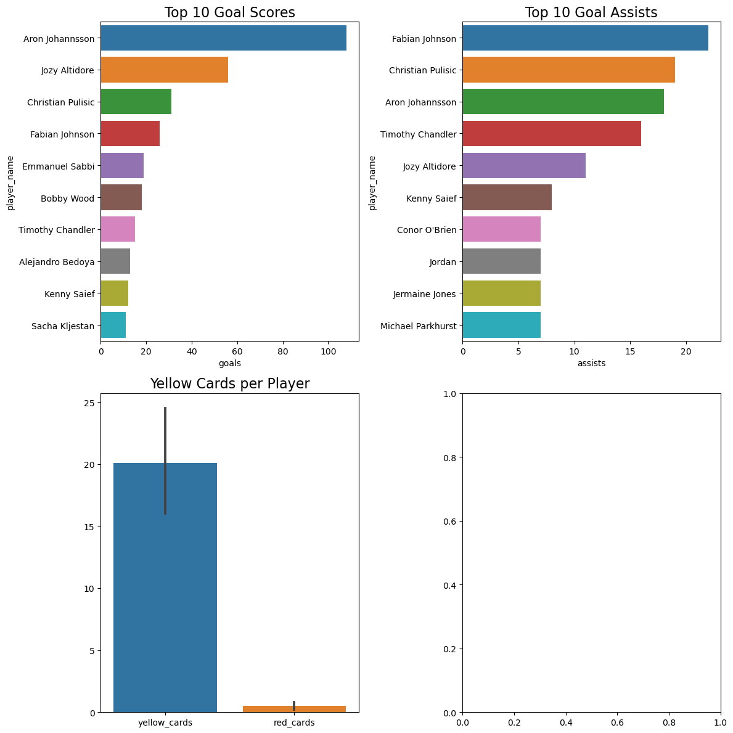
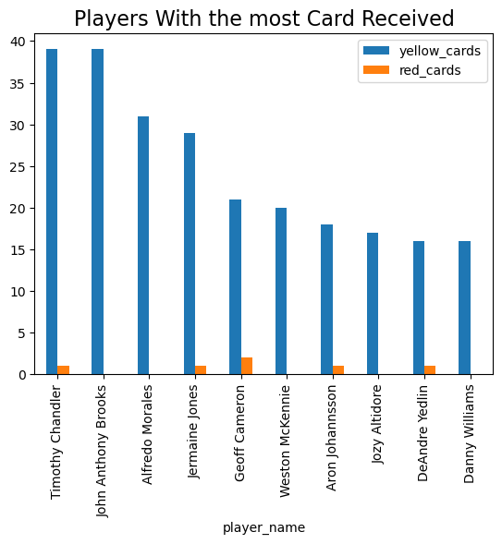
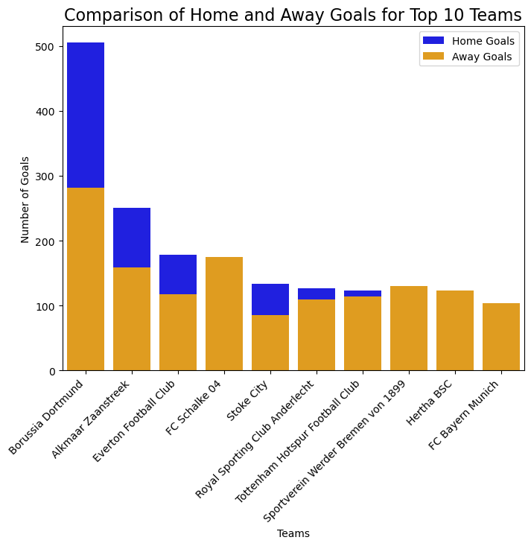
Performance Analysis
1
Key Players
Aron Johannsson and Jozy Altidore are top performers, but their teams are vulnerable to over-reliance on these players.
2
Home vs. Away
Home-field advantage is significant, but teams struggle to maintain consistency away from home.
3
Player Growth
Players have shown consistent improvement this season, but disciplinary issues raise concerns.
4
Disciplinary Concerns
High yellow card counts raise concerns about player discipline.

Slide 6

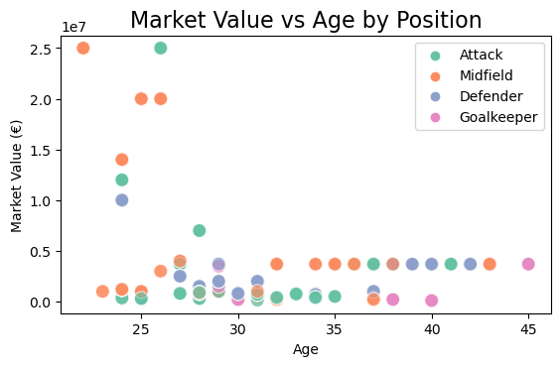
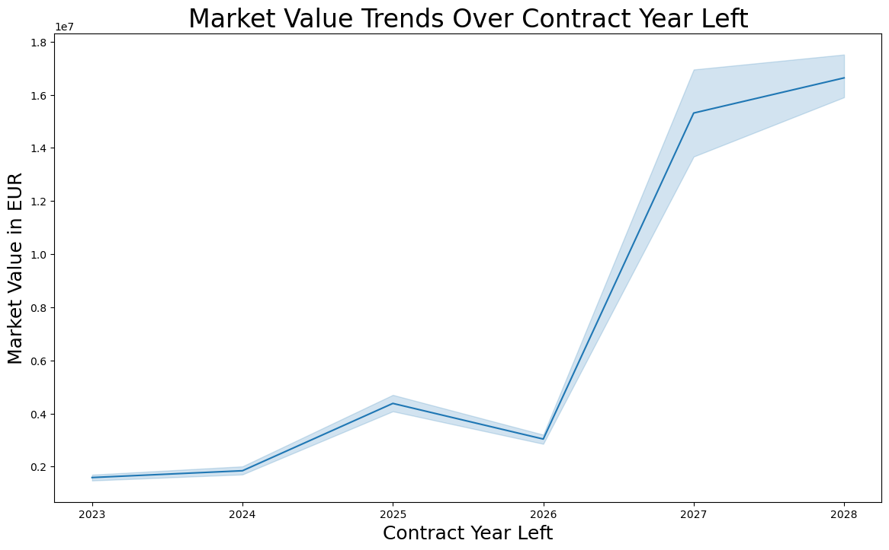
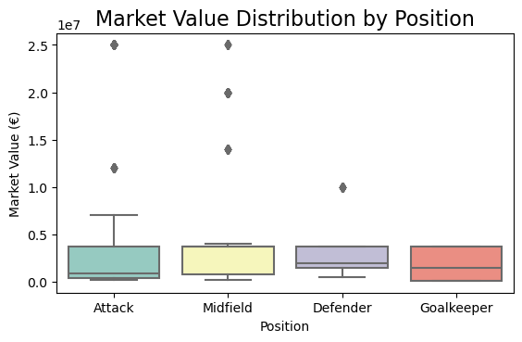
Player Profile and Market Value
Age and Value
Young attackers, particularly those in their early to mid-20s, hold the highest market value.
Contract Expiration
Contract expiration years (2026–2027) show spikes in market value, indicating potential transfer market dynamics.
Market Value by Position:
The Cost of Talent
Attackers hold the highest market values, while goalkeepers have the lowest, with notable outliers across positions.

Slide 7
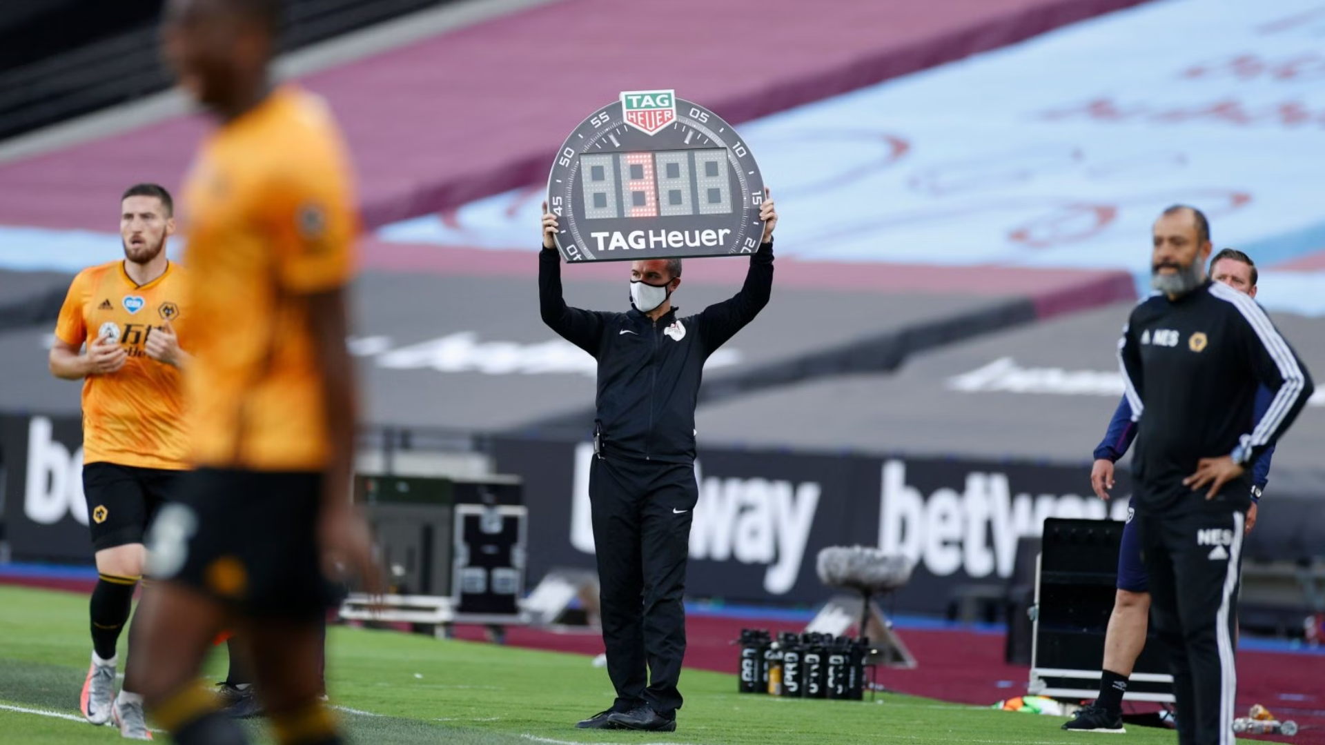
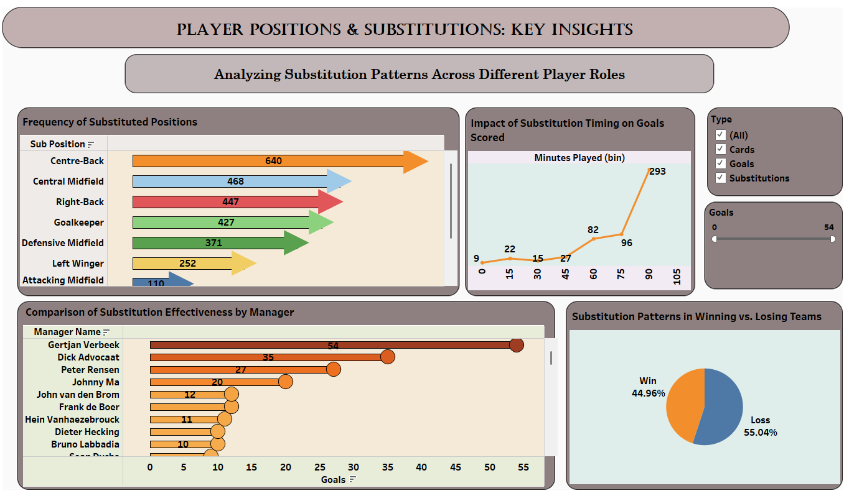




Substitution Patterns
Critical Window
Substitutions made between the 60th and 90th minutes have a substantial influence on goal-scoring.
Managerial Impact
Managers like Gertjan Verbeek and Dick Advocaat excel at maximizing substitution impact.
Substitution Timing
Early substitutions often show limited effect, suggesting a potential area for optimization.
Tactical Shifts
Teams in losing positions tend to rely on reactive substitutions, while winning teams prioritize stability.

Slide 8
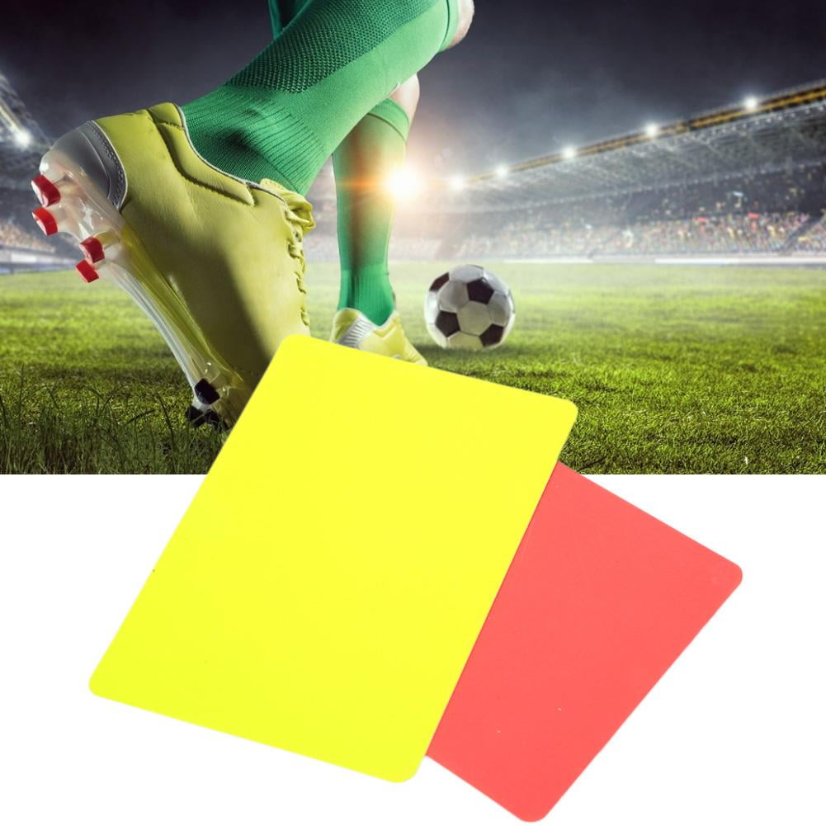
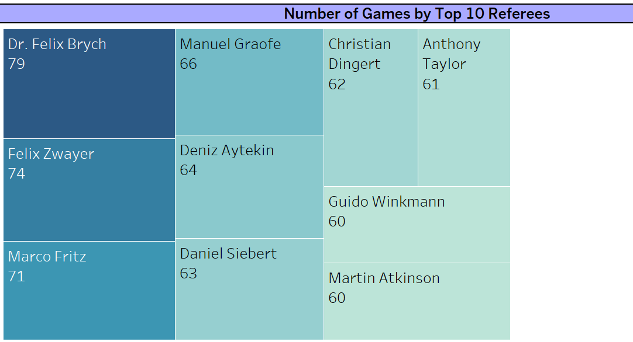
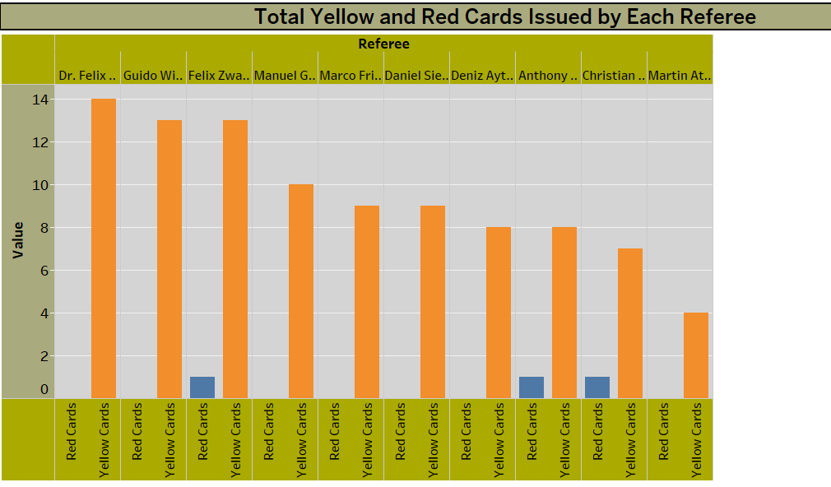
Referee Analysis
For Referee analysis there are two set of questions and these are- 1. NUMBER OF GAMES BY TOP 10 REFEREE - From the top 10 referees ,Dr. Felix Brych is the top referee with 79 games, followed by Manuel Graefe with 66 . 2. TOTAL YELLOW AND RED CARDS ISSUED BY EACH REFEREE - Dr. Felix Brych issued the most cards ( 14 yellow cards ) among the top 10 referees listed.
Only 3 have issued red cards from the top 10 referees listed that are Felix Zwayer , Anthony Taylor and Christian Dingert.

Slide 9
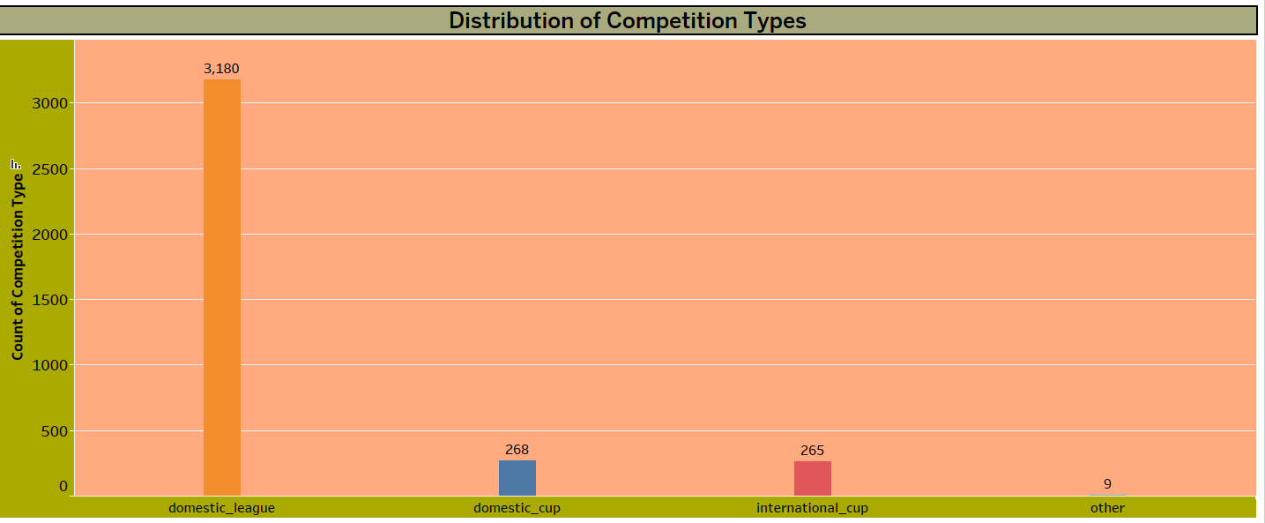
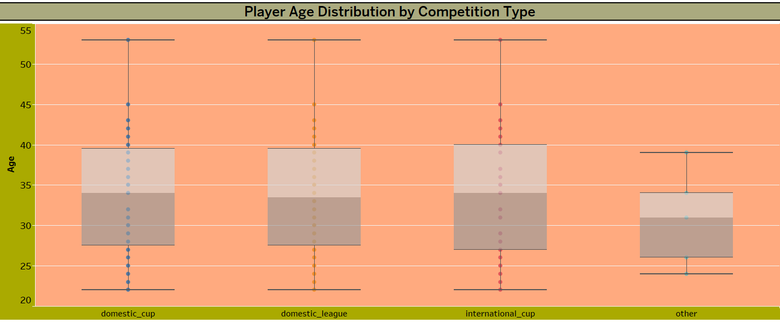
COMPETITION ANALYSIS
For Competition analysis there are two set of questions and these are- 1. DISTRIBUTION OF COMPETITION TYPES - Distribution of competition types, with domestic_league being the most common at 3,180 occurrences, followed by domestic_cup at 268 occurrences, international_cup at 265 occurrences, and other at 9 occurrences. 2. PLAYERS AGE DISTRIBUTION BY COMPETITION TYPE - The age ranges are similar across domestic cup, domestic league, and international cup competitions, with medians around 30-35 years. The other category has a narrower age range with a lower median compared to the other types.

Slide 10
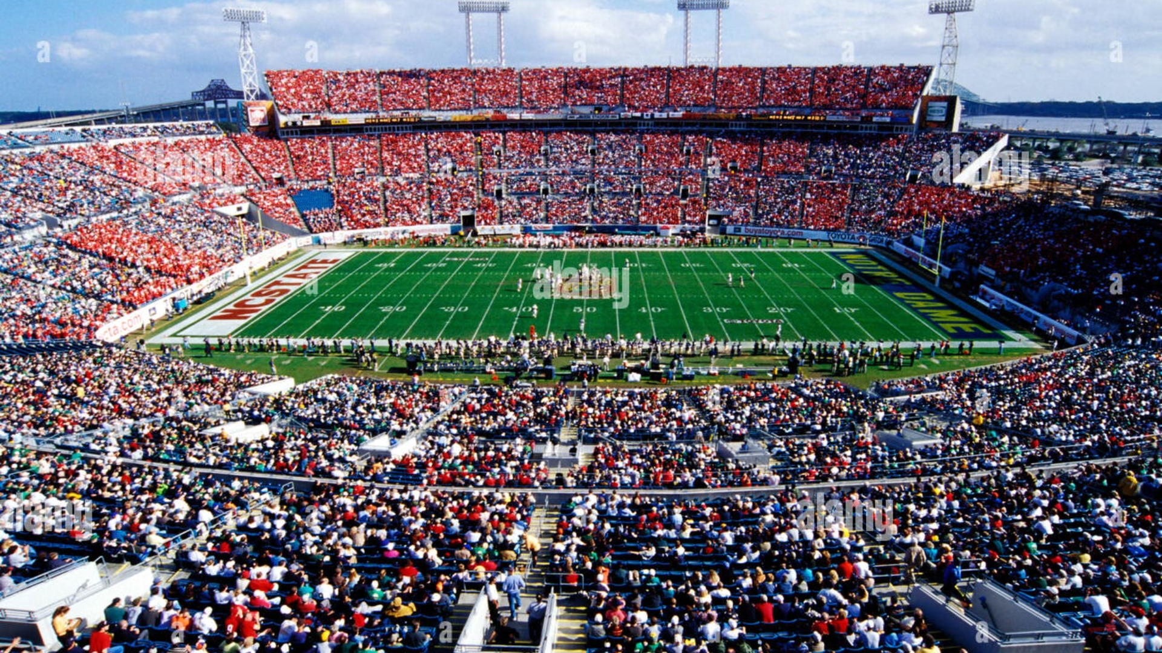
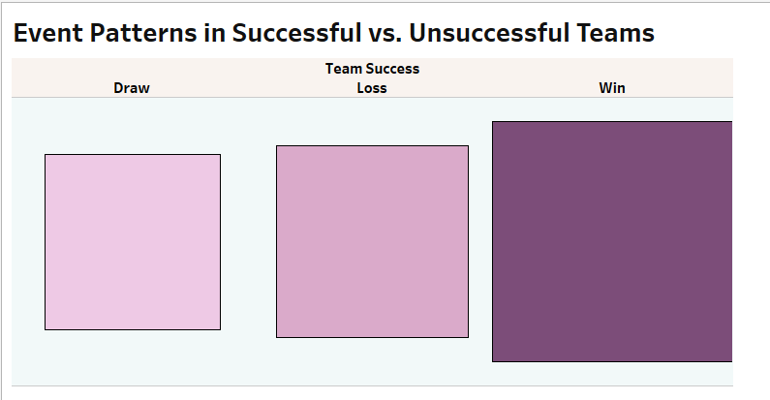
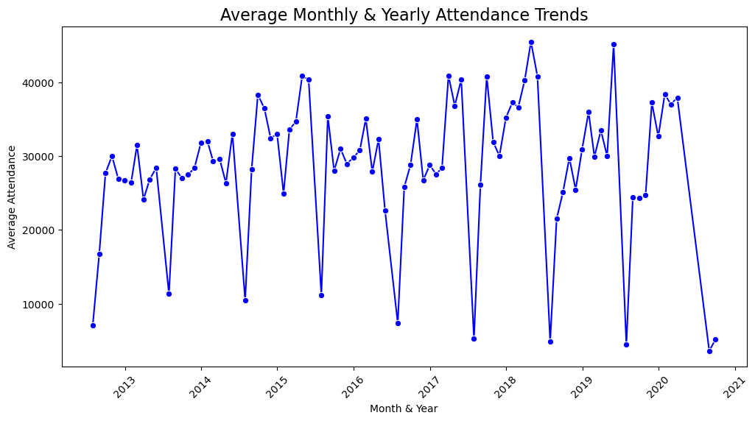
Event & Attendance Analysis
Event Trends:
1
Winning teams excel in goals, substitutions; losing teams face more cards,
especially red.
Growth, Decline & Recovery:
2
Attendance trends reveal consistent growth
until 2019.
A sharp decline in attendance followed due to the
COVID-19 pandemic.
Continued fan engagement is crucial during periods
of lower attendance.

Slide 11
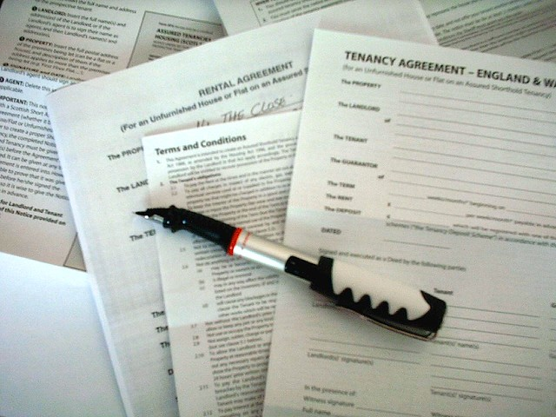
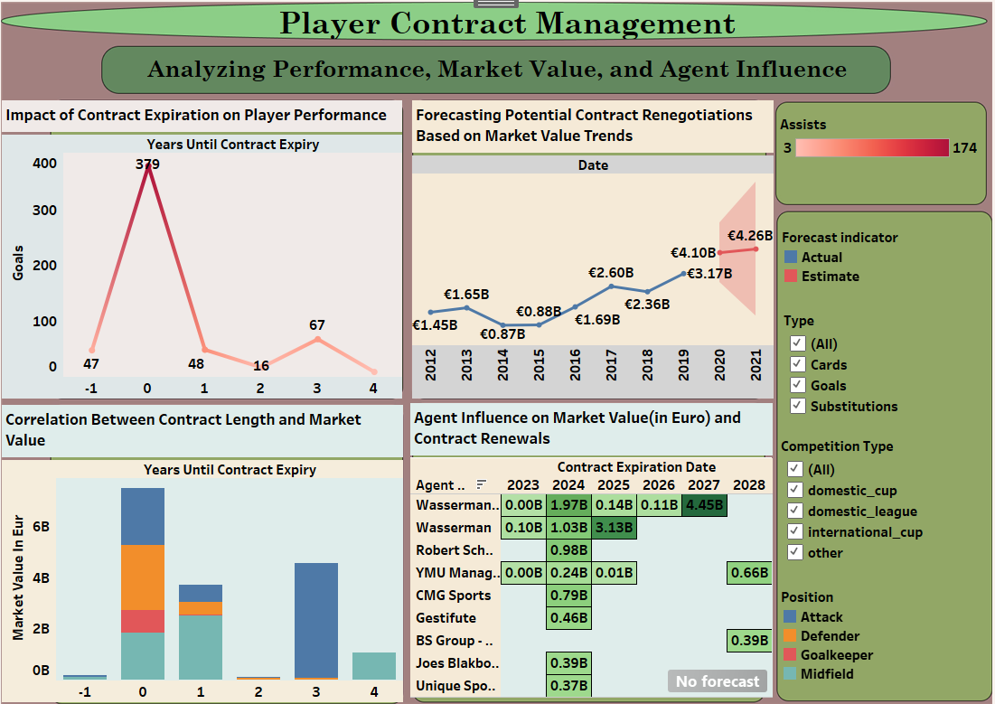
Contract Mangement
Performance and Contract Expiration:
Dashboard links player success to contract expirations, helping identify
who needs contract attention.
Contract Renegotiation Prediction:
Predict players likely seeking new contracts by analyzing market trends
and expiration dates, aiding planning and budgeting.
Contract Length vs. Market worth:
Shows how contract length impacts market worth, balancing stability with
potential higher value in shorter contracts.
Impact of Agents:
Assess agents' impact on market value and contract renewals, refining
negotiation strategies.
Data-Driven Decision Making:
Provides crucial data on market trends and player performance for informed
contract decisions.
Optimized Contract Management:
Leverage insights to manage contracts fairly, focusing on performance,
market value, and agent dynamics.

Slide 12
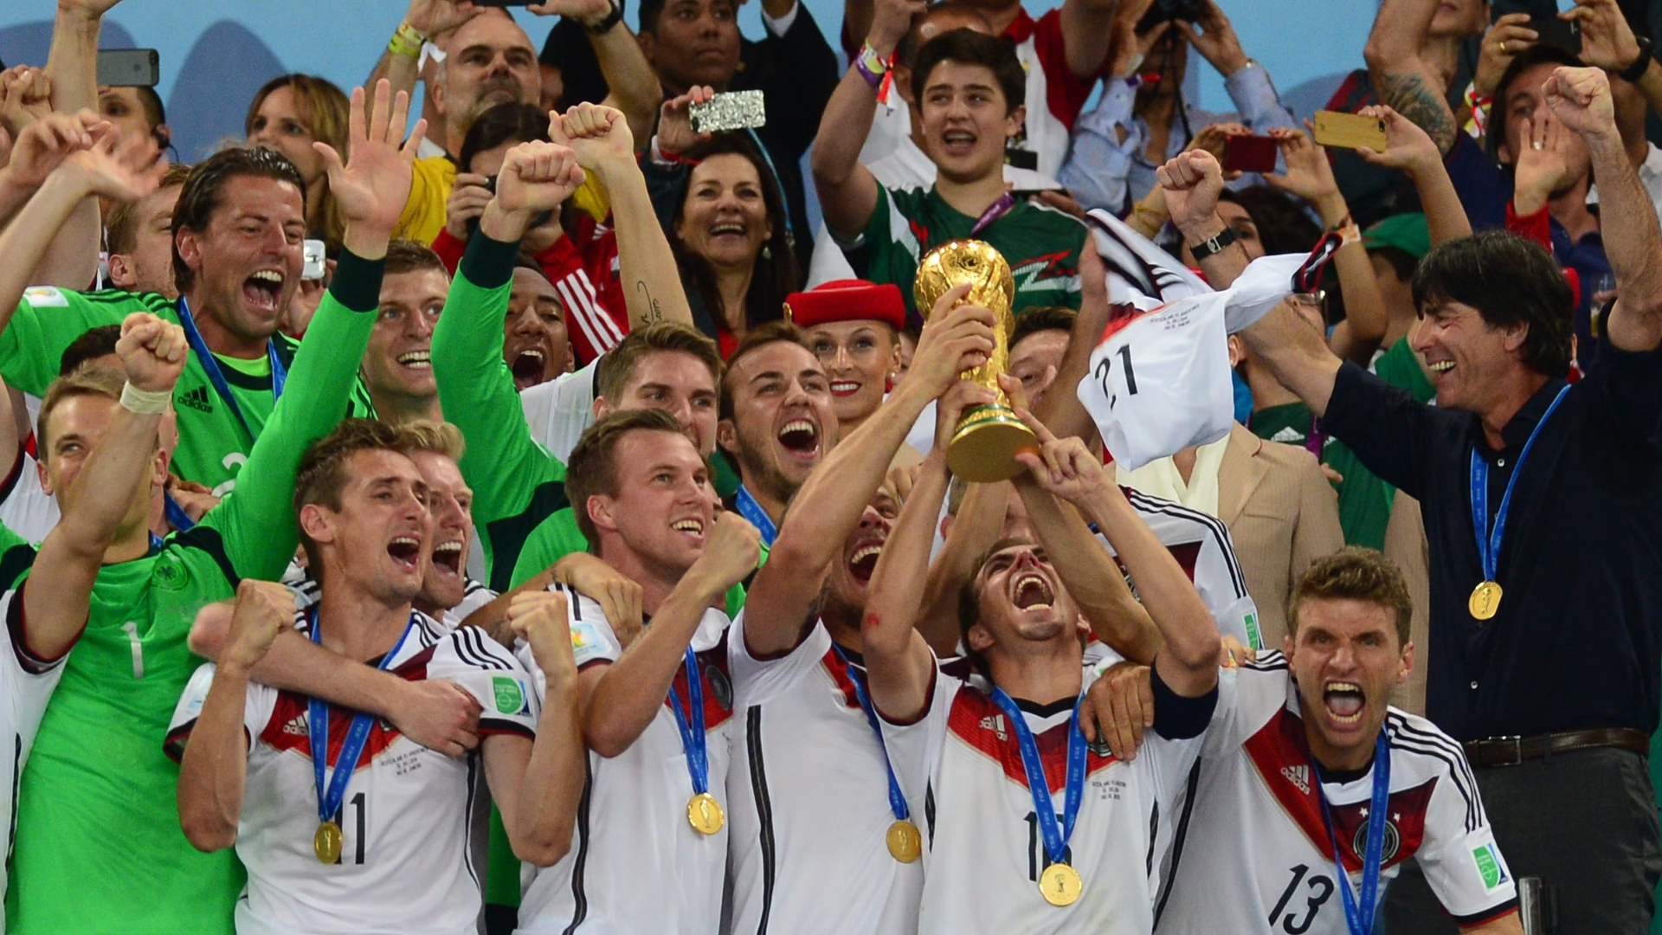
Business Conclusion
Spread the Responsibility
Smart Player Contracts
Fix Away Game Struggles
Teams rely too much on a few star players. To avoid trouble, it's important to develop and use more players.
Teams should be smart with contracts, renewing or selling players when their value is highest.
Teams need to improve their tactics when playing on the road to be more successful.

Slide 13


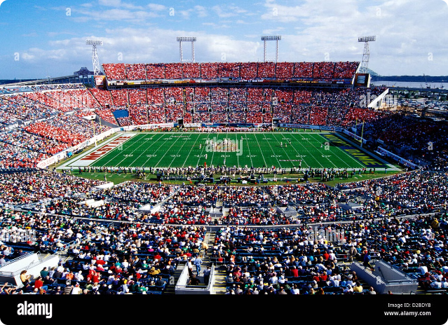
Strategic Recommendations
1
Invest in Player Development
Enhance versatility to minimize reliance on key players.
2
Optimize Contract Negotiation Timing
Leverage performance metrics for better deals.
3
Enhance Fan Engagement
Focus on long-term community connections beyond star players.

Slide 14

Thank You!

